Slide 1



Finance AI Assistant
Retrieval-Augmented Generation for Financial Analysis
Project Overview
A Finance AI Assistant leveraging RAG architecture to provide accurate, context-aware responses to finance queries.
Key Capabilities
Combines FLAN-T5-Large with FAISS vector search for efficient retrieval and generation.
Purpose
Designed for financial analysts, researchers, and investors to access structured, verified financial insights.
By: Rohit Gunnelly
Notes:
Welcome to this presentation on the Finance AI Assistant, an advanced system built to revolutionize the way financial data is accessed and understood. At its core, this assistant combines the power of retrieval-augmented generation with domain-specific datasets to ensure answers are both accurate and highly contextual.
The project integrates the FLAN-T5-Large model with the FAISS vector search engine, enabling it to rapidly locate relevant financial documents and use them as context for natural language generation. This hybrid approach not only reduces hallucinations but also delivers responses grounded in credible data sources.
Its primary use cases are in the finance industry, where timely, precise, and well-explained insights are crucial—whether for equity research, market analysis, or investor decision-making. Over the next slides, we will explore the architecture, performance, and insights gained from evaluating this system.

Slide 2

Introduction to the Finance AI Assistant
Purpose, Use Cases, and Impact
Purpose: Enable fast, accurate, and explainable answers to financial queries.
Target Users: Financial analysts, investors, researchers, and journalists.
Impact: Bridges the gap between raw financial data and actionable insights.
Notes:
The Finance AI Assistant was created with a clear mission: to empower professionals in the finance industry with fast, accurate, and explainable answers to their questions. In a domain where the cost of misinformation can be enormous, precision is key.
Its primary audience includes financial analysts, institutional investors, market researchers, and even journalists covering finance. These are people who work under tight deadlines and require reliable data at their fingertips.
By bridging the gap between raw financial datasets—such as annual reports and market news—and actionable insights, the assistant transforms complex information into knowledge that can directly inform high-stakes decisions.

Slide 3



Core Technology
FLAN-T5-Large and FAISS Vector Search
FLAN-T5-Large
A state-of-the-art language model fine-tuned for instruction-following tasks, enabling nuanced and contextually accurate responses.
FAISS Vector Database
High-performance similarity search library for rapid document retrieval in large datasets.
RAG Integration
Combines retrieval and generation to ground answers in verifiable source data.
Notes:
At the heart of the Finance AI Assistant lies a combination of two powerful technologies: the FLAN-T5-Large language model and the FAISS vector search engine. FLAN-T5-Large excels at understanding and generating natural language with a high degree of accuracy, especially when fine-tuned for domain-specific tasks.
FAISS, developed by Facebook AI Research, is designed for high-speed similarity searches, enabling the assistant to locate the most relevant pieces of financial data in massive document collections almost instantly. This makes it ideal for scenarios where speed and precision are critical.
By integrating retrieval with generation, the system ensures that answers are not only fluent and context-aware but also grounded in actual, verifiable data sources. This architecture minimizes hallucinations and maximizes trustworthiness—a crucial feature for financial applications.

Slide 4

Data Sources
Comprehensive and Credible Financial Information
Annual Reports: Detailed company filings providing official financial statements and disclosures.
Financial Glossary: Extensive dictionary of financial terms to ensure comprehensive understanding.
News Articles: Curated set of financial news updates, especially focused on Apple and market trends.
Notes:
The Finance AI Assistant draws its intelligence from a carefully selected set of primary data sources. The first and most substantial are company annual reports, which provide the official, audited financial statements and narratives that form the backbone of any accurate financial analysis.
To fill in gaps and ensure consistent understanding, the system also integrates a comprehensive financial glossary. This resource defines industry terms and concepts, ensuring that even when specialized jargon appears in reports, the AI can interpret and explain it effectively.
Finally, the assistant incorporates curated financial news articles—particularly around key companies like Apple—to provide timely, contextual insights. These news sources help the AI stay relevant to current events, supplementing the more static information found in reports and glossaries.

Slide 5
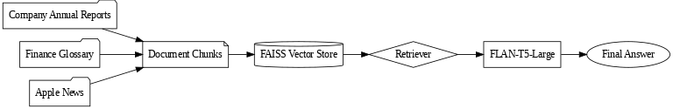



System Architecture Overview
From Data Ingestion to Answer Generation
Data Ingestion
Collect raw documents from annual reports, glossaries, and financial news.
Retrieval + Generation
Retrieve relevant chunks and feed them to FLAN-T5-Large for final answer creation.
Chunking & Indexing
Split documents into manageable pieces and index with FAISS for fast retrieval.
Notes:
The Finance AI Assistant's architecture follows a streamlined yet powerful pipeline. It begins with data ingestion, where the system gathers documents from its three core sources: annual reports, financial glossaries, and curated news articles.
These documents are then split into smaller, context-preserving chunks. This chunking is critical for staying within the token limits of large language models while maintaining the semantic integrity of the data. Each chunk is indexed using FAISS, enabling rapid vector-based similarity searches.
When a user query arrives, the retrieval stage locates the most relevant document chunks. These are then passed to the FLAN-T5-Large model, which integrates the retrieved context with the query to produce a clear, accurate, and contextually grounded response.

Slide 6

Retrieval Process
Optimized Search for Relevant Financial Data
Sub-second Retrieval: FAISS enables near-instant searches even across thousands of document chunks.
Semantic Matching: Queries matched to document vectors for contextual relevance, not just keywords.
Consistent Performance: Maintains speed in multi-document and large dataset scenarios.
Notes:
One of the most impressive aspects of the Finance AI Assistant is the efficiency of its retrieval process. Using FAISS, the system can search through thousands of document chunks in well under a second, even when dealing with multi-document queries.
Instead of relying on keyword matching alone, FAISS uses semantic vector representations, allowing the system to understand the context of a query and match it with relevant information, even when the wording differs.
This performance remains consistent across varying workloads, meaning analysts can rely on it for both quick fact checks and more in-depth, multi-source research without experiencing slowdowns.

Slide 7



LLM Generation Process
Transforming Retrieved Data into Contextual Answers
Context Injection
Relevant document chunks are combined with the query for informed generation.
Natural Language Output
FLAN-T5-Large produces fluent, human-readable responses grounded in source data.
Complex Query Handling
Capable of summaries, comparisons, and explanations beyond simple fact retrieval.
Notes:
Once the retrieval process has located the most relevant information, the LLM generation process begins. The selected document chunks are injected into the prompt alongside the user query, ensuring that the model has both the question and the supporting context at hand.
FLAN-T5-Large then generates a natural language response that is both fluent and aligned with the retrieved data. This makes the output easy to understand while retaining factual accuracy.
This stage is particularly valuable for complex queries, where simple lookups are insufficient. The model can perform multi-document summarization, comparative analysis, and term explanations, providing insights that go beyond basic search capabilities.

Slide 8
DEMO
https://colab.research.google.com/drive/1xNECagMfbrmZcJQHeatCxjvIzvuwuYpK#scrollTo=XKRSWr8Ph1AH
Notes:
Now I will show the Demo

Slide 9



Performance Metrics Summary
Retrieval, Generation, and Total Latency
Retrieval Time
Average retrieval completed in less than 0.06 seconds across queries.
LLM Generation Time
Generation took between ~48s for simple queries and over 120s for complex ones.
Total Latency
Majority of time spent in generation phase rather than retrieval.
Notes:
Performance testing revealed a clear distinction between retrieval and generation times. Retrieval was consistently fast, with most queries completing in less than 0.06 seconds, even when searching across multiple documents.
The LLM generation process, however, accounted for the bulk of total latency. Simple fact-based queries, such as reporting Apple's revenue, took under 50 seconds, while complex summarization tasks, like condensing Tesla's entire annual report, exceeded 120 seconds.
This data confirms that while the retrieval pipeline is highly optimized, future improvements should focus on accelerating the generative step to deliver faster overall response times.

Slide 10


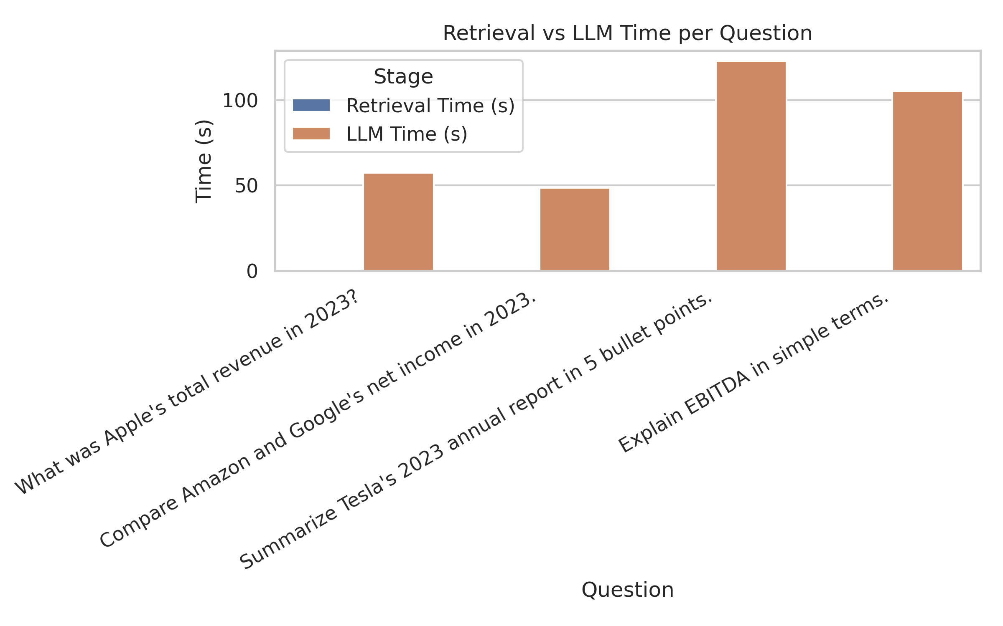

Latency Insights – Grouped Chart
Comparing Retrieval and Generation Times per Query
Visual Comparison
Grouped bar chart highlights stark contrast between retrieval and generation durations.
Generation Dominance
LLM processing time far exceeds retrieval in all cases.
Consistently Low Retrieval
Retrieval times remained negligible across all queries.
Notes:
The grouped bar chart analysis makes one fact abundantly clear: retrieval is not the bottleneck. In every tested query, retrieval times were so short they are barely visible on the chart.
Generation time, on the other hand, dwarfs retrieval across the board. Whether the query was as straightforward as finding Apple's 2023 revenue or as complex as summarizing Tesla's annual report, the LLM step consumed the vast majority of total processing time.
This visualization reinforces the conclusion that system optimization efforts should primarily target the generative model’s processing efficiency rather than the retrieval pipeline.

Slide 11
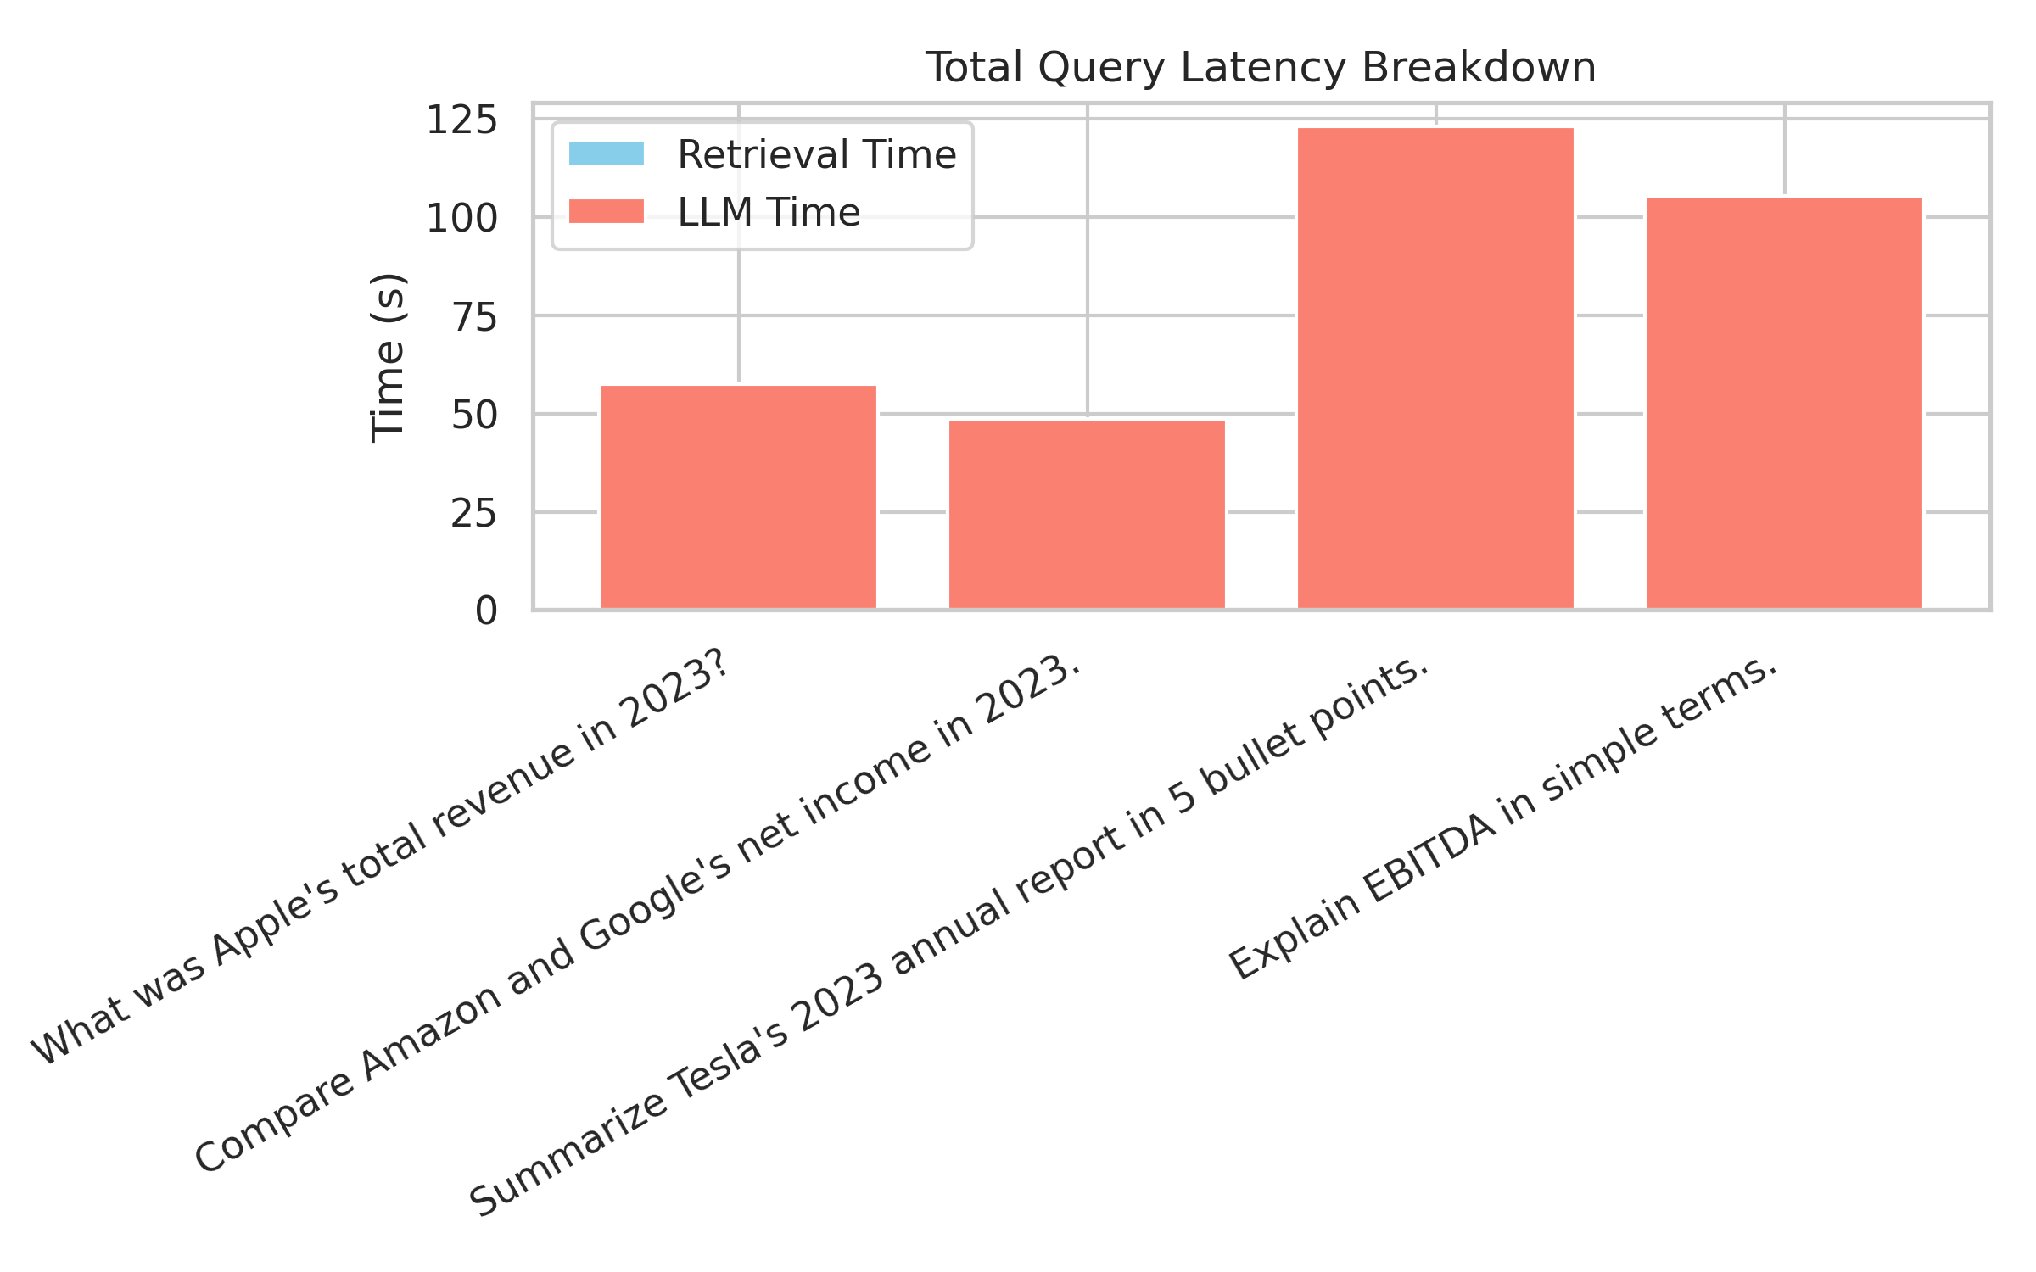
Latency Insights – Stacked Chart
Breakdown of Total Latency by Retrieval and Generation
Stacked Representation: Shows proportion of total latency contributed by retrieval vs. generation.
Minimal Retrieval Load: Retrieval occupies only a small fraction of total time.
Generation Bottleneck: LLM computation dominates the stacked bars in all cases.
Notes:
The stacked bar chart offers a clear proportional view of where latency is occurring. Retrieval is almost negligible in comparison to generation, taking up just a thin segment of each bar.
In contrast, LLM processing dominates each query’s total execution time, often exceeding a hundred seconds for more complex tasks. This is particularly pronounced in summarization queries, where the length and complexity of input text push processing demands higher.
From a system optimization standpoint, this visualization is an invaluable reminder: while retrieval is already performing at peak efficiency, the generation phase is the area where latency reduction efforts will yield the greatest user experience gains.

Slide 12


Query Complexity vs Latency
Impact of Task Type on Processing Time
Simple Queries
Fact-based questions, e.g., revenue lookups, complete in under 50 seconds.
Complex Queries
Tasks like full annual report summaries exceed 120 seconds.
Latency Trade-offs
Greater insight and detail come at the cost of increased processing time.
Notes:
Not all queries are created equal when it comes to latency. Simple fact-based questions—such as 'What was Apple's total revenue in 2023?'—can be processed in under 50 seconds, thanks to the model’s efficiency in handling concise data.
However, complex queries like summarizing Tesla's entire 2023 annual report require far more processing. These tasks often surpass 120 seconds, reflecting the additional computational effort needed to condense and contextualize large volumes of text.
This illustrates a key trade-off: while longer latencies are acceptable for deep, high-value analyses, future system enhancements could aim to reduce these times without compromising answer quality.

Slide 13

Challenges and Solutions
Overcoming Technical and Data Limitations
Token Limitations: Implemented chunking with overlap to fit lengthy documents into LLM constraints.
Coverage Gaps: Added a comprehensive financial glossary to address missing term definitions.
Latency in Complex Queries: Optimization opportunities identified for the generative phase.
Photo by Christina @ wocintechchat.com on Unsplash
Notes:
Building the Finance AI Assistant involved addressing several technical and operational challenges. One major issue was the token limit imposed by large language models. To address this, we designed a chunking strategy with controlled overlap, ensuring large documents could be processed without losing context.
Another hurdle was incomplete coverage of financial terminology in company reports. To solve this, we integrated a detailed financial glossary, enhancing the system’s ability to explain industry-specific terms.
Finally, while retrieval speed met expectations, generation latency—particularly for complex queries—remains an optimization target for future development, where strategies such as model distillation or selective summarization could yield improvements.

Slide 14

Ethical Considerations
Ensuring Compliance, Privacy, and Transparency
Legitimate Data Sources: All documents sourced from public, reputable sources to comply with copyright laws.
User Privacy: No personally identifiable information is stored during processing.
Transparency & Accuracy: Responses grounded in verifiable data with source disclosure.
Notes:
Ethics play a central role in the design and deployment of the Finance AI Assistant. All data used by the system—annual reports, financial glossaries, and news articles—comes from publicly available and reputable sources, ensuring compliance with copyright and licensing laws.
The system is also built with a strong commitment to privacy. It does not store any personally identifiable information, making it safe for users to query without concerns about data retention or misuse.
Transparency is another pillar of the system. Every response is grounded in verifiable sources, and those sources are disclosed, allowing users to independently confirm the information they receive. This helps maintain both the accuracy and trustworthiness of the system’s outputs.

Slide 15



Conclusion & Future Improvements
Enhancing Performance and Expanding Capabilities
Proven Architecture
RAG-based system effectively delivers accurate and contextual financial insights.
Performance Focus
Future work aims to reduce LLM generation latency for faster responses.
Feature Expansion
Plans include real-time market data integration and web-based deployment.
Notes:
The Finance AI Assistant demonstrates that combining efficient retrieval with a robust generative model can yield highly accurate, context-aware financial insights. The RAG architecture, powered by FAISS and FLAN-T5-Large, ensures that users get information grounded in credible sources.
Looking ahead, the most impactful improvement area is reducing LLM generation latency. By accelerating the generative step, the overall user experience can become far more responsive, particularly for complex queries.
Feature expansion is also on the roadmap, with real-time market data integration and deployment as an interactive web application among the top priorities. These enhancements will bring the system closer to being an indispensable tool for financial professionals worldwide.

